Slide 1
COMP 201 OPEN SOURCE & SYSTEM ADMINISTRATION
DANIEL OBUOBI, DCSIT, CU
Vi & File Processing

Slide 2
Using the vi Editor
Notes:
This lecture covers Chapter 5 Section 5.3.

Slide 3
The vi Editor Objectives
After studying this lesson, you should be able to:
Create and edit simple documents using the vi editor

Slide 4
Using Operating System Editors
Operating system editors let you create and edit simple text files.
UNIX includes three editors:
vi
emacs
pico
We only cover vi in this lecture.

Slide 5
vi Editor
vi is not user-friendly! You have to remember all of the commands, in addition to which mode the editor is in.
However, vi is very powerful and fast once you have mastered it.
The vi editor remains the choice of most UNIX users.

Slide 6
The view Utility
The view utility is a read-only version of vi.
When you open a file with view, you can use vi commands, but you cannot accidentally change the file by saving your changes.

Slide 7
Two Modes
Vi works in two modes:
command mode lets you enter commands that perform specific vi functions.
insert mode lets you type text into a file.
When you first enter the vi editor, it's always in command mode. Before you can type text in the file, you must type one of the vi insert commands, such as i ("insert"), to insert text at the current cursor location.

Slide 8
Two Modes (Contd)
Because vi doesn't indicate which mode you're currently in, distinguishing between command mode and insert mode is probably the single greatest cause of confusion among new vi users.
Whenever you want to return vi to command mode, press Esc.
If you're not sure which mode vi is presently in, simply press Esc to make sure it's in command mode and continue from there.

Slide 9
Command Mode
Most vi commands consist of one or two letters and an optional number.
Usually, uppercase and lowercase versions of commands perform related but different functions.
typing a appends the file to the right of the cursor, while typing A appends the file at the end of the line.

Slide 10
Command Mode (Contd)
Most vi commands do not require that you press Enter to execute them.
However, commands beginning with a colon (:) do require that you press Enter after the command.
Some books refer to these commands as last-line mode commands, since when you type the colon while in command mode, the colon and the remainder of what is typed appear on the bottom line of the screen.

Slide 11
Insert Mode
To type text in a file, type the vi "insert" command i. This command removes vi from command mode and puts it into insert mode.
There are other vi insert commands which are covered later.
When you finish typing text, press Esc to return to command mode. Then you can type more vi commands.
If vi seems to act unpredictably, make sure that you are not in "Caps Lock", which would cause your entries to be all capital letters.

Slide 12
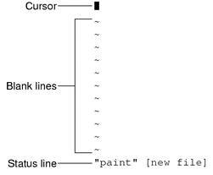
Starting and Quitting vi
Starting:
vi paint begin editing the file paint
vi you can name the file later

Slide 13
Starting and Quitting vi (Contd)
Quitting (used only in command mode):
Saving
:w (when you are entering in long files, please use :w to save them often)
:w filename (save to filename)
Saving and Quitting
:wq
Alternatively, type ZZ
Quitting Without Saving
:q (assumes no changes made)
:q! (discard any changes that were made)

Slide 14
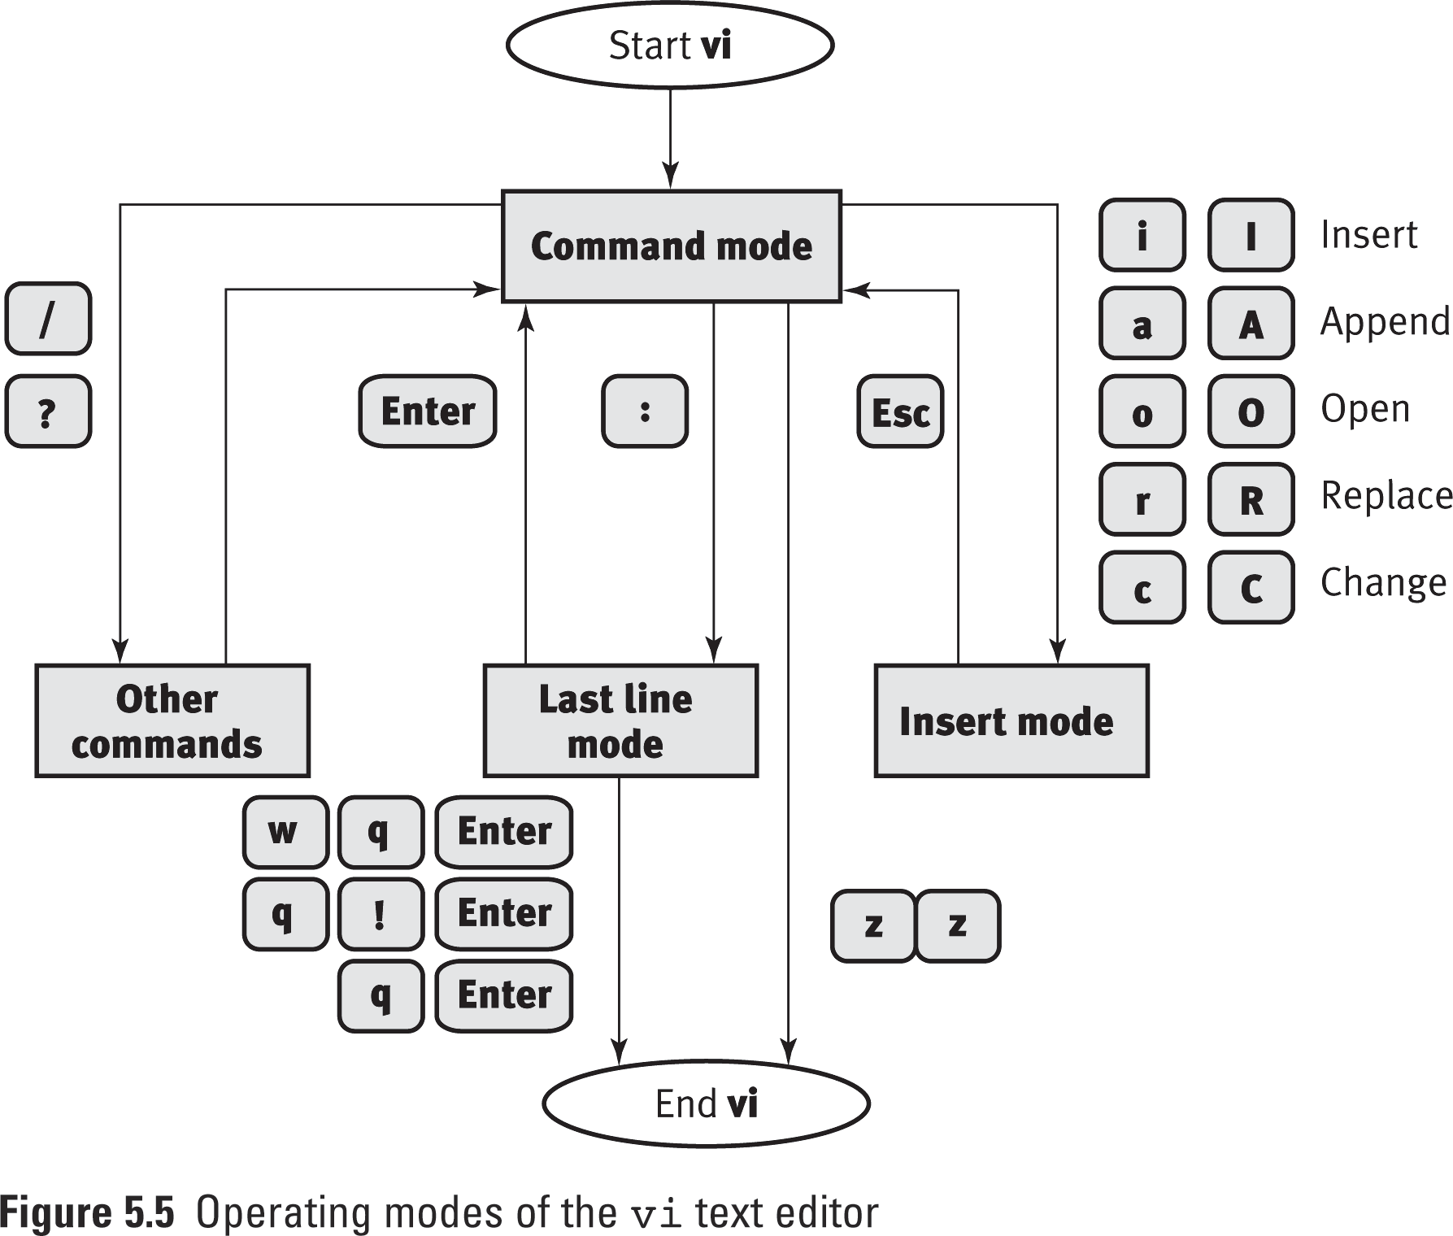

Slide 15
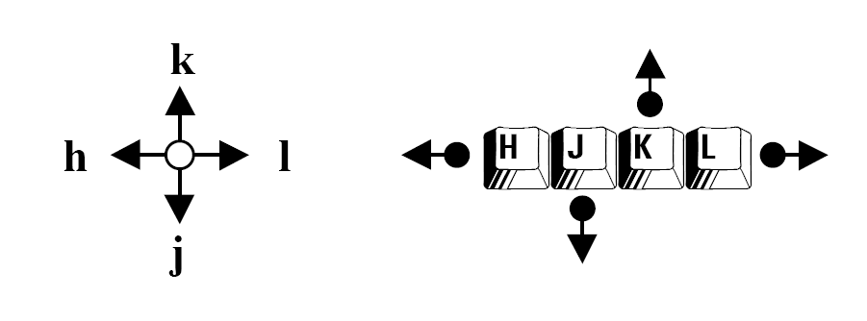
Moving Around in a File
Although the <PageUp> and <PageDown> arrow keys work on some systems, the following commands are guaranteed to work properly on all systems.
vi equivalent
Left Arrow h
Right Arrow l
Up Arrow k
Down Arrow j

Slide 16
Moving Around in a File (Contd)
vi equivalent
Page forward one screen (Ctrl-F)
Page backward one screen (Ctrl-B)
Start of the current line 0 (zero)
End of the current line $
First line of the file 1G
Last line of the file G

Slide 17
Inserting Text
The insert commands places vi in insert mode. To use any of these commands, you must first be in command mode. Remember to press Esc to make sure you are in command mode.
Insert
i insert text to the left of the cursor (This is the command you will use most often)
I insert text at the beginning of a line
Append
a insert text to the right of the cursor (This command is most useful when your cursor is at the end of a line and you wish to add more text)
A add text to the end of a line
Open line
o open a line below the current cursor position
O open a line above the current cursor position

Slide 18
Changing Text
Changing a Word cw
Position the cursor at the beginning of the word to be replaced, type cw, followed by the new word. To finish, press Esc.
To change part of a word, place the cursor on the word, to the right of the portion to be saved. Type cw, type the correction, and press Esc.
Substituting Character(s) s
To substitute one or more characters for the character under the cursor, type s, followed by the new text. Press Esc to return to command mode.
Replacing One Character r
Position the cursor over the character and type r, followed by just one replacement character.
After the substitution, vi automatically returns to command mode (you do not need to press Esc).

Slide 19
Redo and Undo
Repeating a change
. (period)
Undo a command
u
If you make a mistake, you can "undo" the mistake by immediately issuing the undo command by entering u.

Slide 20
Deleting Text
The delete commands delete the character, word, or line you indicate. vi stays in command mode, so any subsequent text insertions must be preceded by additional commands to enter insert mode.
Delete character at cursor x
Delete character before cursor (backspace) X
Delete the word starting at the cursor; if the cursor is in the middle of the word, delete from the cursor to the end of the word dw
Delete current line dd

Slide 21
Deleting Text (Contd)
Note that many of the above commands can be preceded by a number, for example:
9x delete 9 characters
3dd delete 3 lines
5dw delete 5 words

Slide 22
Setting Line Number
Show line numbers :set nu
Turn off line numbers :set nonu
display current line number/file name Ctrl-G

Slide 23
Displaying the current vi mode
:set showmode
Put a message at the bottom right corner of your screen, indicating insert, append, replace, change, or open modes. There is no message if you are in the command mode.
Note: This feature does not work on all versions of UNIX
Abbreviate the command :set smd

Slide 24
Going to a Specific Line
Go to the last line of an open file G
Return to the first line 1G
Go to any other line by typing its number followed by G
Go to line 12 12G

Slide 25
Copying Text
The vi command-mode equivalent of “copy and paste” is yank and put.
yy or Y (“yank”), p (“put below”), P (“put above”)
copy current line to "clipboard“ yy
paste contents of "clipboard" below current line p
paste contents of "clipboard" above current line P
copy current line, and next 4 lines to "clipboard“ 5yy

Slide 26
Searching for a Pattern
You can search forward for a pattern of characters by typing a forward slash (/), typing the pattern you are seeking, and then pressing Enter
Examples:
search forward (down) for "hello" /hello
search again, (same direction as original) n

Slide 27
Searching for a Pattern (Contd)
set case insensitive search :set ic
set case sensitive search :set noic
search backward (up) for "hello" ?hello
search again, (opposite direction as original) N
Certain special characters ( / & ! . ^ * $ \ ?) have special significance to the search process and must be "escaped" when they are used in a search.
To escape a special character, precede it with a backslash (\).
To search for the string "anything?" type /anything\? and press Enter.

Slide 28
Refining the Search
To match the beginning of a line, start the search string with a caret (^). For example, to find the next line beginning with “search", type /^Search
search for "hello" at start of a line /^hello
search for "hello" at end of a line /hello$
search for "hello" or "Hello“ /[hH]ello
search for "int" as a word (i.e. not print or sprint) /\<int\>
search for "eat" but not "beat" or "neat“ /\[^bn]eat

Slide 29
Substituting Text
The format of the substitute command as it is typed on the last line is
:[range]s/old_string/new_string[/option]
Where
anything enclosed in [ ] is not mandatory
: is the colon prefix for the last line command
range is a valid specification of lines (if omitted, the current line is the range)

Slide 30
Substituting Text (Contd)
:[range]s/old_string/new_string[/option]
s is the syntax of the substitute command
old_string is the text you want to replace
/ is a delimiter for replacement
new_string is the new text
/option is a modifier to the command, g for global, c for confirm

Slide 31
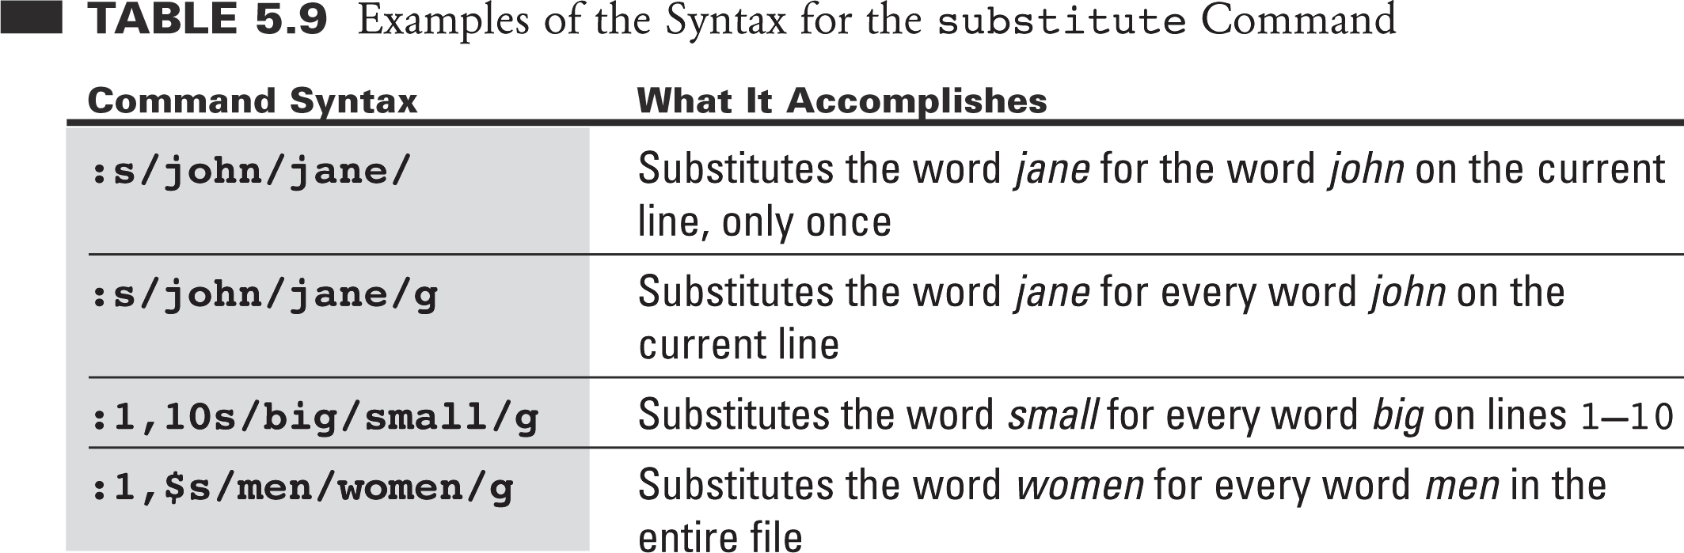
Examples of Substituting Text

Slide 32
More Examples
:s/big/small/c
replace “big” with “small” (first occurrence of big) on the current line but confirm the replacement.
type y, press Enter to confirm
type n, press Enter to ignore
:1,$s/dog/cat/gc
replace “dog” with “cat” (every occurrence) for the entire file but confirm each replacement

Slide 33
Insert One File Into Another
vi makes it convenient to "read" (insert) a file into the file you are editing.
: line# r filename
If you do not specify a line number, vi inserts the file at the current cursor position.
For example, if you wanted to insert the file result1at line 24 of the file result2, you would type:
:24 r result1
Or you could position the cursor on line 24 and type:
:r result1

Slide 34
Multiple files
vi enables you to edit multiple files. For example, to edit the file result1 while you are editing result2:
First, save your current work in result2. Type :w and press Enter.
To edit result1, type :n result1 and press Enter.
Make editing changes to result1 and save your work.
When you are finished working with result1 and have saved your work, you have three choices:
Exit vi. Type :q and press enter.
enter to result2. Type :n # and press enter.
Swap back and forth between two files with the command :n #.

Slide 35
Executing Shell Commands from Within vi
:! Shell command
Allow you execute a shell command without quitting vi. After executing a shell command, vi returns to its Command Mode.
:! pwd
:! ls

Slide 36
UNIX File Processing
Notes:
Redirection and piping (Chap 12 Secs 12.1-12.12)
Regular expressions (Chap 10 Sec 10.2)
Sort, find, grep (Chap 10 Secs 10.4-10.6)

Slide 37
Objectives
After studying this lesson, you should be able to understand and use:
Redirection
Pipes
Wildcards and Regular Expressions
Commands:
cat, find, grep, sort, more, wc, head

Slide 38
Standard Files
All commands perform at least one of the following operations:
Input, processing, output
A typical command performs all three.
In UNIX three standard files are automatically opened by the kernel for every command to read input from and send its output and error messages to. The three standard files are:
Standard Input (stdin)
Standard Output (stdout)
Standard Error (stderr)

Slide 39
Standard Files (Contd)
By default
stdin is associated with keyboard
stdout is associated with screen
stderr is associated with screen
The input ,output and errors of a command can be redirected to other files by using file redirection facilities in UNIX.

Slide 40
File Redirection Operators
<
Redirect input, read input from a file
>
Redirect output, send it to a file
>>
Redirect output, append it to a file
Notes:
The 0 and 1 file descriptors are implied, and not used explicitly for the C shell. The C shell representation for standard error (2) is an ampersand (&). STDERR can only be redirected when redirecting STDOUT.
Redirect STDOUT and STDERR to file >& file
Append STDOUT and STDERR to file >>& file

Slide 41
Redirecting Outputs
command > output-file
Send output of ‘command’ to the file ‘output-file’ instead of the monitor screen
ls > foo
Send the directory list to the file named “foo”
cat foo
Show contents of “foo”
date >> foo
Append the date to the file name “foo”

Slide 42
Cat: Concatenate and Display Files
The cat utility reads each file in sequence and writes it on the standard output.
Examples:
cat myfile
writes the contents of the file myfile to standard output
cat doc1 doc2 >doc.all
concatenates the files doc1 and doc2 and writes the result to doc.all.

Slide 43
Redirecting Outputs (Contd)
ls -l > bar
Send the long directory list to “bar”
cat foo bar > foobar
Combine “foo” and “bar” into a new file named “foobar”
cat foobar
Display contents of file “foobar”

Slide 44
Redirecting Inputs
command < input-file
‘command’ takes input from ‘input-file’ instead of the keyboard
who > people
Put the list of users currently on the system into the file “people”
sort < people
Sort by sending “people” as input to sort

Slide 45
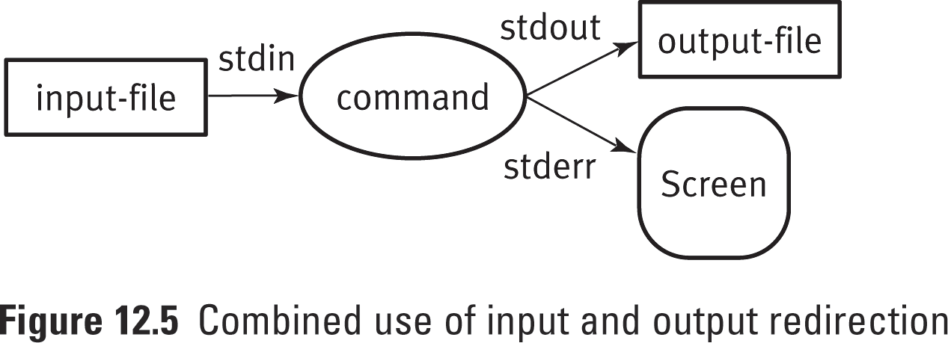
Combining Input and Output Redirection
command < input-file > output-file
command > output-file < input-file
Input to ‘command’ comes from the ‘input-file’ instead of the keyboard, and the output of the command goes to the ‘output-file’ instead of the display screen
sort < people > speople
Send sorted list to new file “speople”

Slide 46
Unix Pipes (|)
The pipe operator (|) redirects the output of one command to the input of another command
first_command | second_command
The pipe connects the output of the first command with the input of the second command
first_command | second_command | third_command ...
The pipe operator can connect several commands on the same command line

Slide 47
Pipes Examples
who > people
sort < people
People acts as a temporary file. Is there a shortcut? Yes, using pipes.
who | sort
List of users on the system

Slide 48
Pipes Examples (Contd)
who | wc –l
How many users are on the system?
wc display a count of lines, words, and characters in a file (-l count lines, -w count words, -c count characters)
ls –l | more
Display the long listing page by page
more browse or page through a text file

Slide 49
Wildcards
* matches any # of characters (0 or more).
? matches exactly one character.
[ ] and - : character range, a way to specify a sub range of characters to match.

Slide 50
Wildcard Examples
ls foo*
Lists all files starting with “foo”
ls *.c
Lists all files ending with “.c”
ls f.?
Lists all files named “f.” plus an extra character, such as “f.1” or “f.c”

Slide 51
Wildcard Examples (Contd)
ls a* d* f*
List all files starting with a, d, f
ls [adf]*
same
ls [a-z]*
List files starting with any letter
ls [a-z] *
List all one letter files, then all files

Slide 52
Sorting Files
The sort command sorts lines of text files. It reads information and sorts it alphabetically.
sort [options] [file-list]
Options
-b Ignore leading blanks.
-d Sort in dictionary order (Only letters, digits, and blanks are significant).
-f Ignore the case of words.
-n Sort in numerical order.
-r Reverse the order of the sort.
+n1 [-n2] Specify a field as the sort key, starting with +n1 and ending at –n2 (or end of line if –n2 is not specified); field numbers start with 0.

Slide 53
Sorting Examples
By default, the ls command sorts the files in a case-sensitive manner. It first lists files that begin with uppercase letters and then lists those that begin with lowercase letters.
To force ls to list output one file per line, you can use the -1 option (that’s number one, not a lowercase L).
To sort filenames alphabetically regardless of case, you can use sort –f.

Slide 54

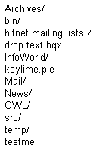
Sorting Examples
ls -1F ls -1F | sort -f

Slide 55
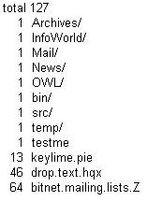
Sorting Examples (Contd)
Of the files in your home directory, which are the largest? The ls –s command indicate the size of each file, in blocks, and sort –n sorts numerically:
ls –s | sort -n

Slide 56
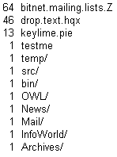
Sorting Questions
Q9: It would be more convenient if the largest files were listed first in the output. What command will have the following output?

Slide 57

Sorting Examples (Contd)
Instead of listing all the files, use the head command, and specify that your want to see only the top five entries.
head display first few lines of files
ls –s | sort –nr | head -5

Slide 58
Finding Files
The find command can be used to find whether a particular file exists in your file structure.
find path… expression
path A path of a starting point in the directory hierachy.
Although Linux does not use it, other UNIX versions require the -print option after the filename to display the names of fields the find command locates.

Slide 59
Finding Files (Contd)
Useful expressions for the find command:
-exec command Execute command.
-ctime n True if the file was created n days ago.
-mtime n True if the file was modified n days ago.
-name pattern True if the filename matches pattern.
-print Print names of the files matched.
-type c True if the files if of type c (d Directory, f File, l Link)
-user uname True if the file is owned by user uname.

Slide 60
Finding Examples
To find just those files that are C source files (those that have a .c suffix) in your current working directory.
find . –name ‘*.c’ –print
To find just those files that have been modified in the past seven days.
find . –mtime -7 –name ‘*.c’ –print
find . –mtime 7 –name ‘*.c’ –print will match only those files that were modified exactly seven days ago.

Slide 61
Finding Examples (Contd)
To find a list of directories in your current working directory:
find . –type d –print
To find more information about each of the above directories, you can use –exec option:
find . –type d –exec ls –ld {} \;
The –exec option must be used with { }, which will be replaced by the matched filename, and \; at the end of the command. And there is a space between the {} and the \; characters.

Slide 62
Questions
Q10: Look across the /dev and /sbin directories for filenames that contain the pattern cp.
Q11: Find those C source files that haven’t been modified for at least 30 days.

Slide 63
Questions
The find command is commonly used to remove core files that are more than a few days old. These core files are copies of the actual memory image of a running program when the program dies unexpectedly.
Q12: Find all files called core that have a creation time that’s more than four days ago.
Q13: Remove the core files.

Slide 64
grep
You can use find to search for files, and you can use grep to search within files.
grep search the files for a pattern
grep [options] pattern [files]
grep means global regular expression print.

Slide 65
grep options
The most helpful grep options:
-c List a count of matching lines only
-i Ignore the case of the letters in the pattern.
-l List only the names of files that contain the specified pattern.
-n Include line numbers.

Slide 66
grep examples
Find all the lines that contain a string matching the expression “foo” in the file “file”:
grep foo file
Find all the lines that contains “cse251” in the password file:
grep cse251 /etc/passwd

Slide 67
grep examples (Contd)
To number the output lines:
grep -n cse251 /etc/passwd
Suppse ~/State directory contains one file for every state in the US, and each file contains the name of all the cities in the state. To find the names of states that have a city called Portland:
grep -l Portland ~/States

Slide 68
Regular Expressions
^ Beginning of the line
$ End of the line
. Any single character
[ ] Matches any character enclosed in brackets.
[^] Matches any character not enclosed in brackets.
* Repetition (0 or more times)

